Slide 1

ScotPHO, Git & Github
Vicky Elliott
Principal Information Analyst – ScotPHO
(Scottish Public Health Observatory)

Slide 2
Why does ScotPHO team Git & Github?
It enables us to share code easily across organisations not on NSS network (cuts down IRs)
Make code available to public
Version control (track changes, see who is working on what, protect a live copy, roll back if we make mistakes)
Collaboration/simultaneous editing of a complex coding project (you still need to co-ordinate between analysts who is doing what)

Slide 3
The lingo...
Git – version control system – tracks changes in code
GitBash – an application that can be used to send Git commands to your computer (although this is not the only way to control Git if you are using Rstudio).
GitHub – A private company (subsidiary of Microsoft) providing hosting service that allows users to make use of Git on their code projects

Slide 4
ScotPHO Github
https://github.com/ScotPHO
Multiple repositories (repo) linked with various ScotPHO projects
Mostly contain R scripts (some python)
Only the ScotPHO team can edit but anyone can enjoy....

Slide 5
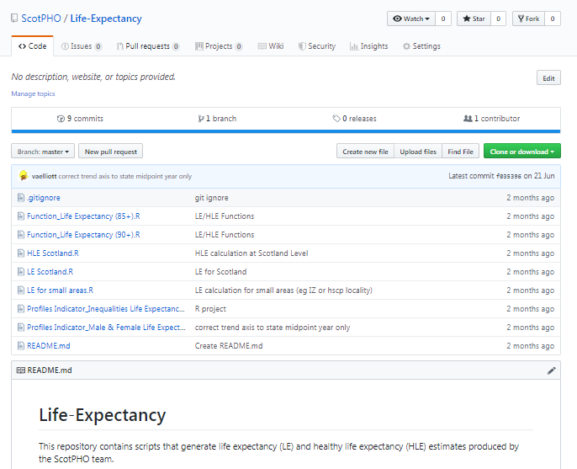
Simple example repo 1: https://github.com/ScotPHO/Life-Expectancy

Slide 6
All code relating to LE/HLE in same area, converted who process to R and reduce duplication of code.
With github you can...
Look at (i.e. steal) code within Github
Clone the repo and view/edit code using Rstudio (you can’t change the code unless you have permissions to the ScotPHO Github account)
Data files are saved in NSS network and not accessible to the public (as long as you don’t upload them)

Slide 7
Could have used scripts saved on network folder...but this folder accessible to NRS and ONS who also produce these outputs.
Anyone in the team can edit the programs and a history of these changes is available

Slide 8
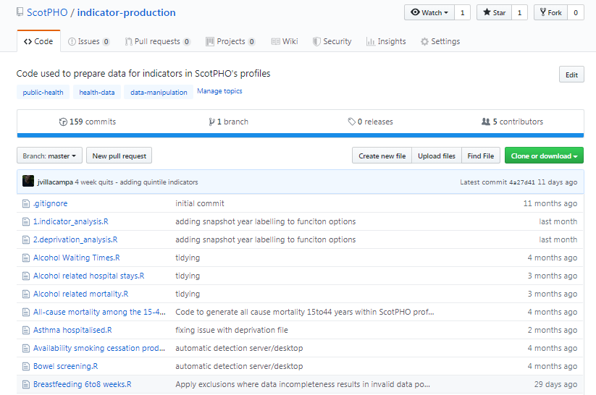
Example repo 2 – getting a bit more complicated https://github.com/ScotPHO/indicator-production

Slide 9
Indicator updates repo
50 (ish) scripts, just some of the scripts used to generate data used within our ScotPHO profiles
4 people contributing code but all of us are transforming data to produce very similar outputs (crude rates/percentages/standardised rates)
GitHub repo
Helps us to be sure we are always using the most up to data functions
Complete history of versions of programs (without clogging up network with Versions...)
Slicker code QA review - ?learning from others
Easy to request specific help from the team.
Also code available to the public so our methods open to scrutiny
Good source of example R scripts for anyone to borrow

Slide 10
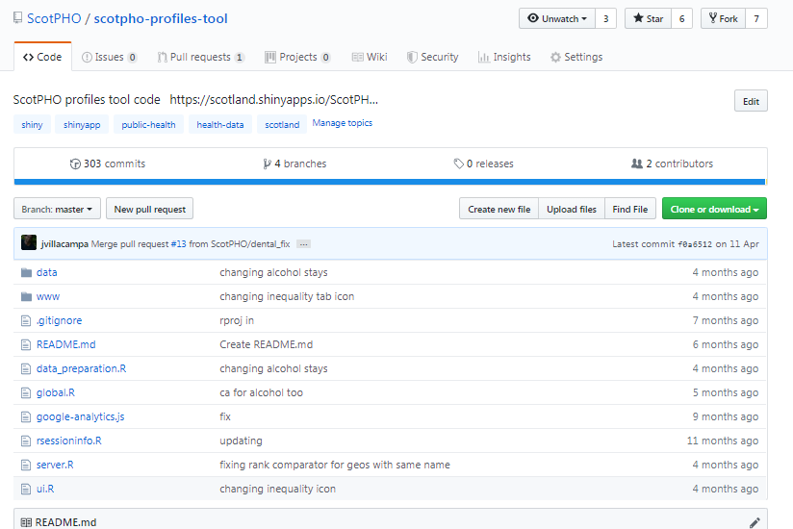
Example repo 3 – getting more complicated https://github.com/ScotPHO/scotpho-profiles-tool

Slide 11
Profile tool repository
Github essential for ScotPHO Rshiny app development (we couldn’t function with any efficiency without branches)
Version control (confidence of knowing we can go back)
Simultaneous editing (although still need a plan of who is working on what)
Available to public (needed this to enter Rstudio contest)

Slide 12
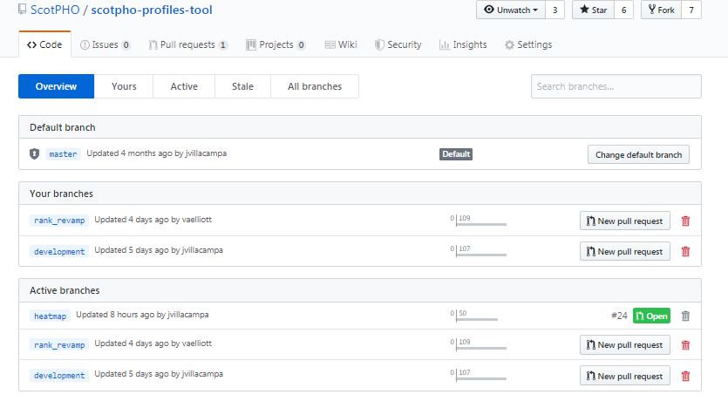
Branches.....
Notes:
Master branch – live version of the app – leave this alone until you are sure what you want to change doesn’t have unintended consequences
Development branch – this is the version where you can test changes
Change specific branches – e.g. Rank_revamp, heatmap

Slide 13
Pull requests
A team member creates a pull request – this effective asks another team member to review any changes to the code.
Reviewer can see all the changes made to code
Using Rstudio switch project to the branch & test out changes – approve, reject, ammend or comment on them

Slide 14
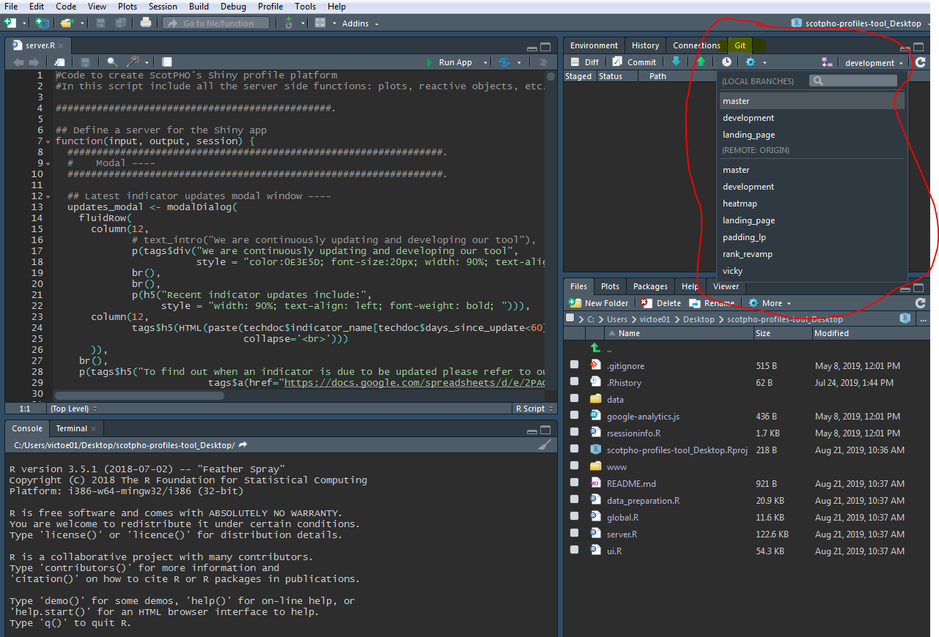
Git & RStudio

Slide 15
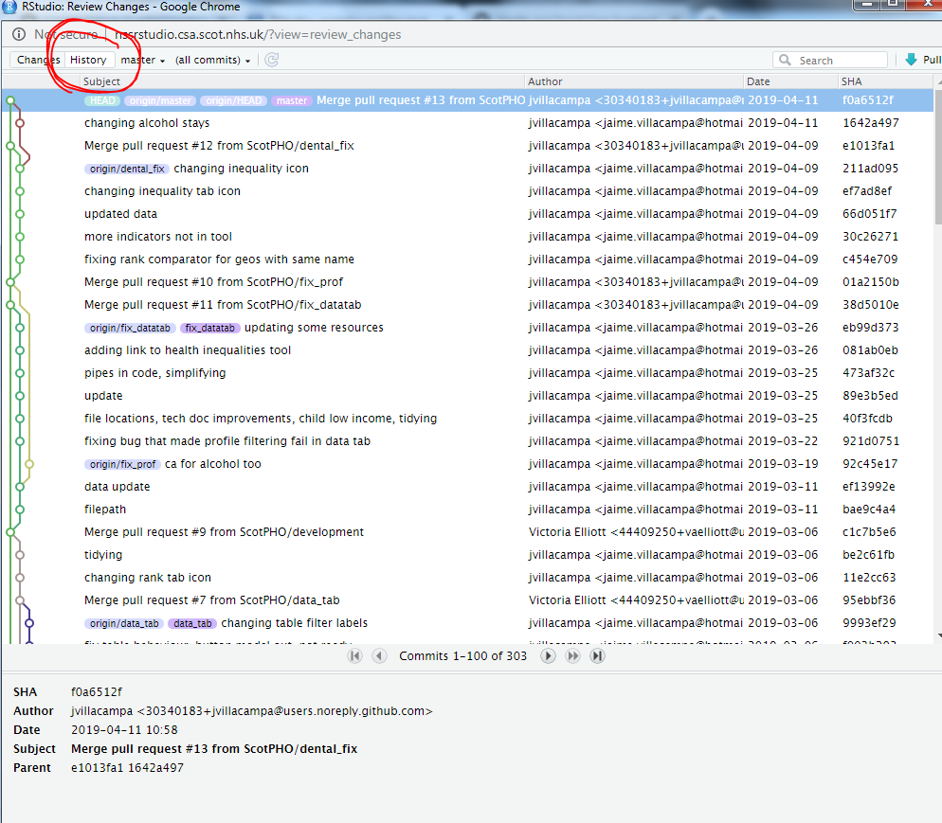
Look at history

Slide 16
Where’s the code?
Edit code using Git commit(s) – becomes staged ready for synchronising
Synchronise code in different locations using Git push/pull
Scotpho-profiles-tool
Vicky’s local copy (Desktop)
Scotpho-profiles-tool
Vicky’s local copy (Desktop)
Commit
Git PUSH
scotpho-profiles-tool
GitHub
Scotpho-profiles-tool
Vicky’s local copy (RServer)
Scotpho-profiles-tool
Vicky’s local copy (RServer)
Commit
Scotpho-profiles-tool
Jaime’s local copy (Desktop)
Scotpho-profiles-tool
Jaime’s local copy (Desktop)
Git PULL
Commit
Scotpho-profiles-tool
Jaime’s local copy (RServer)
Scotpho-profiles-tool
Jaime’s local copy (RServer)
Commit

Slide 17
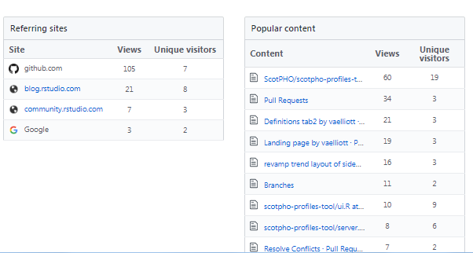
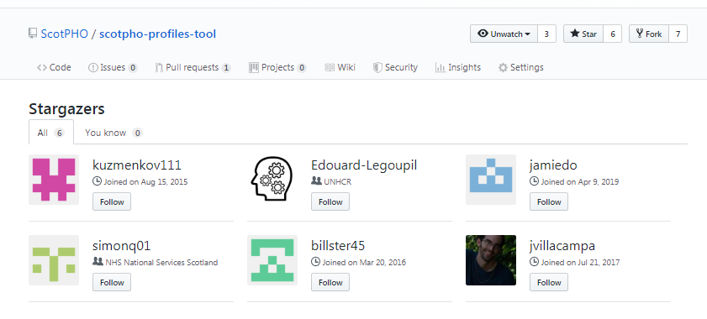
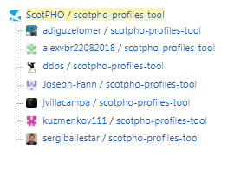
GitHub Insights

Slide 18
What do you need to use Git/Github
Git & Git bash installed on your machine (request to IT via service now portal– they come together)
GitHub account if you want to use GitHub
A project suited to using it, patience & perseverance

Slide 19
Where do you get help?
TPP team
https://github.com/NHS-NSS-transforming-publications/git-guide
https://github.com/NHS-NSS-transforming-publications/GitHub-guidance
Colleagues, Internet, YouTube

